Slide 1
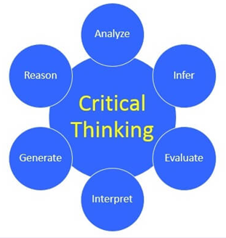
Review of Chapter 1
Critical thinking means skilled judgment or observation by clear intellectual standards
Eight standards of critical thinking:
Clarity
Accuracy
Precision
Relevance
Consistency
Logical correctness
Completeness
Fairness
Barriers to critical thinking:
Egocentrism
Sociocentrism
Unwarranted assumption
Relativistic thinking
Wishful thinking

Slide 2
ASSIGNMENT
Find five real-life examples (with sources): one student contributes ONE example about each of the following:
lack or presence of standards of critical thinking
Barriers to critical thinking
Notes:
- Delete all the lesson slides, only keep the Assignment slides and resubmit your group file to the link below.
- All websites of critical thinking are excluded.
- Deadline: end of Saturday

Slide 3
Real-life Example 1
Năm 2006, Liu tốt nghiệp ĐH Hàng không Vũ trụ Bắc Kinh và bắt tay vào tìm kiếm công việc. Cầm trong tay tấm bằng tốt nghiệp của một trường đại học danh tiếng, Liu tràn đầy tự tin mình sẽ tìm được công việc với mức lương mơ ước.
Ngay sau đó, Liu trúng tuyển vào doanh nghiệp nhà nước ở tỉnh Thiểm Tây. Vì mới ra trường, Liu chỉ đảm nhận chức vụ nhỏ với mức lương khá thấp.
Chưa đầy một năm sau, Liu từ chức vì mức lương mà công ty đưa ra không đáp ứng được kỳ vọng của mình.(1) Từng là thủ khoa kỳ thi đại học, được người người ca tụng, Liu Qui khó chấp nhận việc làm nhân viên cấp thấp.(2)
(1):Self-serving bias:
Brief explanation: He only thinks about how the company pays him but doesn’t think how much he will and can contribute to the company.
(2):Self-interested thinking:
Brief explanation: He overrated his ability and skills eventhou he has never taken a job before. He also denied the fact that he has to start from the bottom in order to get to the higher position despite his lack of experience.
Source:https://zingnews.vn/thu-khoa-thi-dai-hoc-o-trung-quoc-thanh-ke-an-bam-suot-9-nam-post1331626.html
Notes:
Nguyễn Việt Khang-EEACIU22209
Nguyễn Lê Nam Anh – EEACIU22221
Phạm Ngọc Thế Huy-EEACIU22210
Phạm Nguyên Khoa-EEACIU22212
Trần Quang Cường-EEACIU22214
Nguyễn Văn Gia Huy-EEACU22231

Slide 4
Real-life Example 5
Làm từ thiện nhưng tiktoker Nờ Ô Nô lại gây tranh cãi khi có những lời lẽ được cho không đúng mực. "Đó coi đi, số khổ nó khổ vậy đó, (1) người ta nghèo thì chọn ăn món gì như bào ngư vi cá đồ đó chứ sao chọn ăn phở. Thôi chúc bà vượt qua mùa đông cô đơn lạnh giá, bớt nghèo lại đi nha chứ nghèo hoài không ai giúp mãi được đâu".
Dù lên tiếng hối lỗi nhưng sau đó anh lại có những phát ngôn rất thách thức: (3)"Không bao giờ tẩy chay được tôi" hay "Cuộc sống tôi - tôi sống, cuộc sống các bạn - các bạn sống. Một người làm còn hơn không làm".
(1) Lack of logical correctness: The lady is so poor that she cannot be affordable for types of food as the TikToker said.
(2) Self-interested thinking/Subjectivism
Brief explanation: He insists on his own opinion and ignores/denies the request to make him more sensible.
Source:https://2sao.vn/tiktoker-no-o-no-bi-so-gay-sau-phat-ngon-soc-khi-lam-tu-thien-n-328796.html
Notes:
Nguyễn Việt Khang-EEACIU22209
Nguyễn Lê Nam Anh – EEACIU22221
Phạm Ngọc Thế Huy-EEACIU22210
Phạm Nguyên Khoa-EEACIU22212
Trần Quang Cường-EEACIU22214
Nguyễn Văn Gia Huy-EEACU22231

Slide 5
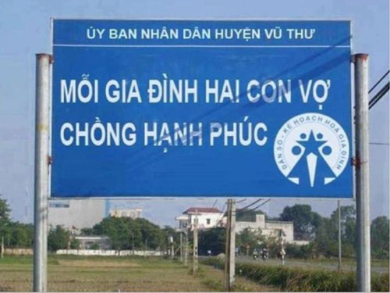
Real-life Example 5
Brief explanation: This board is meant to understand as having TWO children, will help the wife and husband happy. This board lacks clarity because of a missing comma which can make the reader misunderstood the message.
Source: Báo Thanh Niên
Notes:
Vũ Đình Kiên EEACIU22225
Lê Tấn Duy + EEACIU22208
Trần Gia Bảo EEACIU22217
Nguyễn Võ Minh Thông + EEACIU22230
Nguyễn Minh Duy+ EEACIU22223

Slide 6
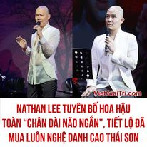
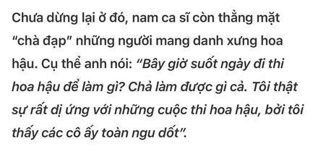
Real-life Example 2
1
2
Brief explanation:
(1):Unwarranted assumption
Brief explanation: He takes it for granted; he believes it to be the truth without even thinking about it or without any evidence about what did he just say?
(2): Self-interested thinking/Subjectivism
Brief explanation: Before his strong words, the people thought that he was too angry to control his emotions. He insists on his own opinion to make him feel more comfortable.
Source: https://s.vgt.tv/XeiB?fbclid=IwAR0Iz3_md3ccbTHXjbhAiGMHq9RBdUMeUnllYYpFI-7o-ToQVZLoS8zXZkw
Notes:
Bùi Ngọc Anh-IELSIU22332
Trần Minh Hạnh-IELSIU22324
Dương Kiều Ngân-IELSIU22333
Phan Đại Nghĩa-IELSIU22286
Đỗ Nhật Bảo Trân-IELSIU22319
Phạm Ngọc Vĩnh-IELSIU22273
Nguyễn Văn Vĩnh-EEACIU22174

Slide 7

Real-life Example 4
(1) Missing logical correctness
Brief explanation: Typically, she should have apologized to his boyfriend because it was her fault. However, in this case, she wanted his boyfriend to admit his mistake through no fault of his own.
(2) Self-interested thinking (Egocentrism)
Brief explanation: Although she was the one who made the mistake, she not only refused to accept responsibility for it but also insisted on being the one to receive an apology.
Source: https://www.youtube.com/watch?v=rzUpGAmhgPc
Notes:
1. Nguyễn Hải Vân Trang + IELSIU22339 2. Phan Vũ Minh Ngọc + IELSIU22340 3. Lê Thị Quỳnh Như + IELSIU22336 4. Nguyễn Hồ Thanh Ngân + IELSIU22338 5. Dương Diễm Quỳnh + IELSIU22266 6. Trần Thị Minh Anh + IELSIU22010 7. Nguyễn Thúy An + IELSIU22298

Slide 8
Real life example 1:
Về trường hợp ông Nguyễn Xuân Anh, cựu Ủy viên Trung ương Đảng, cựu Bí thư Thành ủy, cựu Chủ tịch HĐND thành phố Đà Nẵng nhiệm kỳ 2016-2021. Khi mới nhậm chức lãnh đạo cao nhất thành phố Đà Nẵng, ông Nguyễn Xuân Anh đã có những phát ngôn làm nức lòng nhiều CB, ĐV, nhân dân địa phương và thu hút sự quan tâm của dư luận xã hội, như: “Không có quyền lực ngoài pháp luật” thế nhưng ông lại vi phạm nguyên tắc tập trung dân chủ và các quy định của Đảng, Nhà nước về công tác cán bộ; chủ trì xem xét, quyết định một số nhân sự có biểu hiện áp đặt; trực tiếp chỉ đạo nhiều công việc cụ thể của chính quyền.
⇒ Practical inconsistency
Brief explanation: In two different periods, what he said and what he did are not consistent.
Source: https://www.qdnd.vn/phong-chong-tu-dien-bien-tu-chuyen-hoa/noi-khong-di-doi-voi-lam-benh-trong-can-giai-nguy-chua-gap-617783
https://tuoitre.vn/4-vi-pham-nghiem-trong-cua-bi-thu-nguyen-xuan-anh-20170919080555981.htm
Notes:
Truong Quang Khai - IEIEIU22077
Hoàng Ngọc Minh IEIEIU22076
Trần Văn Hiếu - IEIEIU22079
Nguyễn Trần Anh Thư - IEIEIU22038
Nguyễn Ngọc Uyên Phương - IEIEIU22030
Đặng Huỳnh Anh Huy - IELSIU22316
Hoàng Hải Phong - IELSIU22320

Slide 9
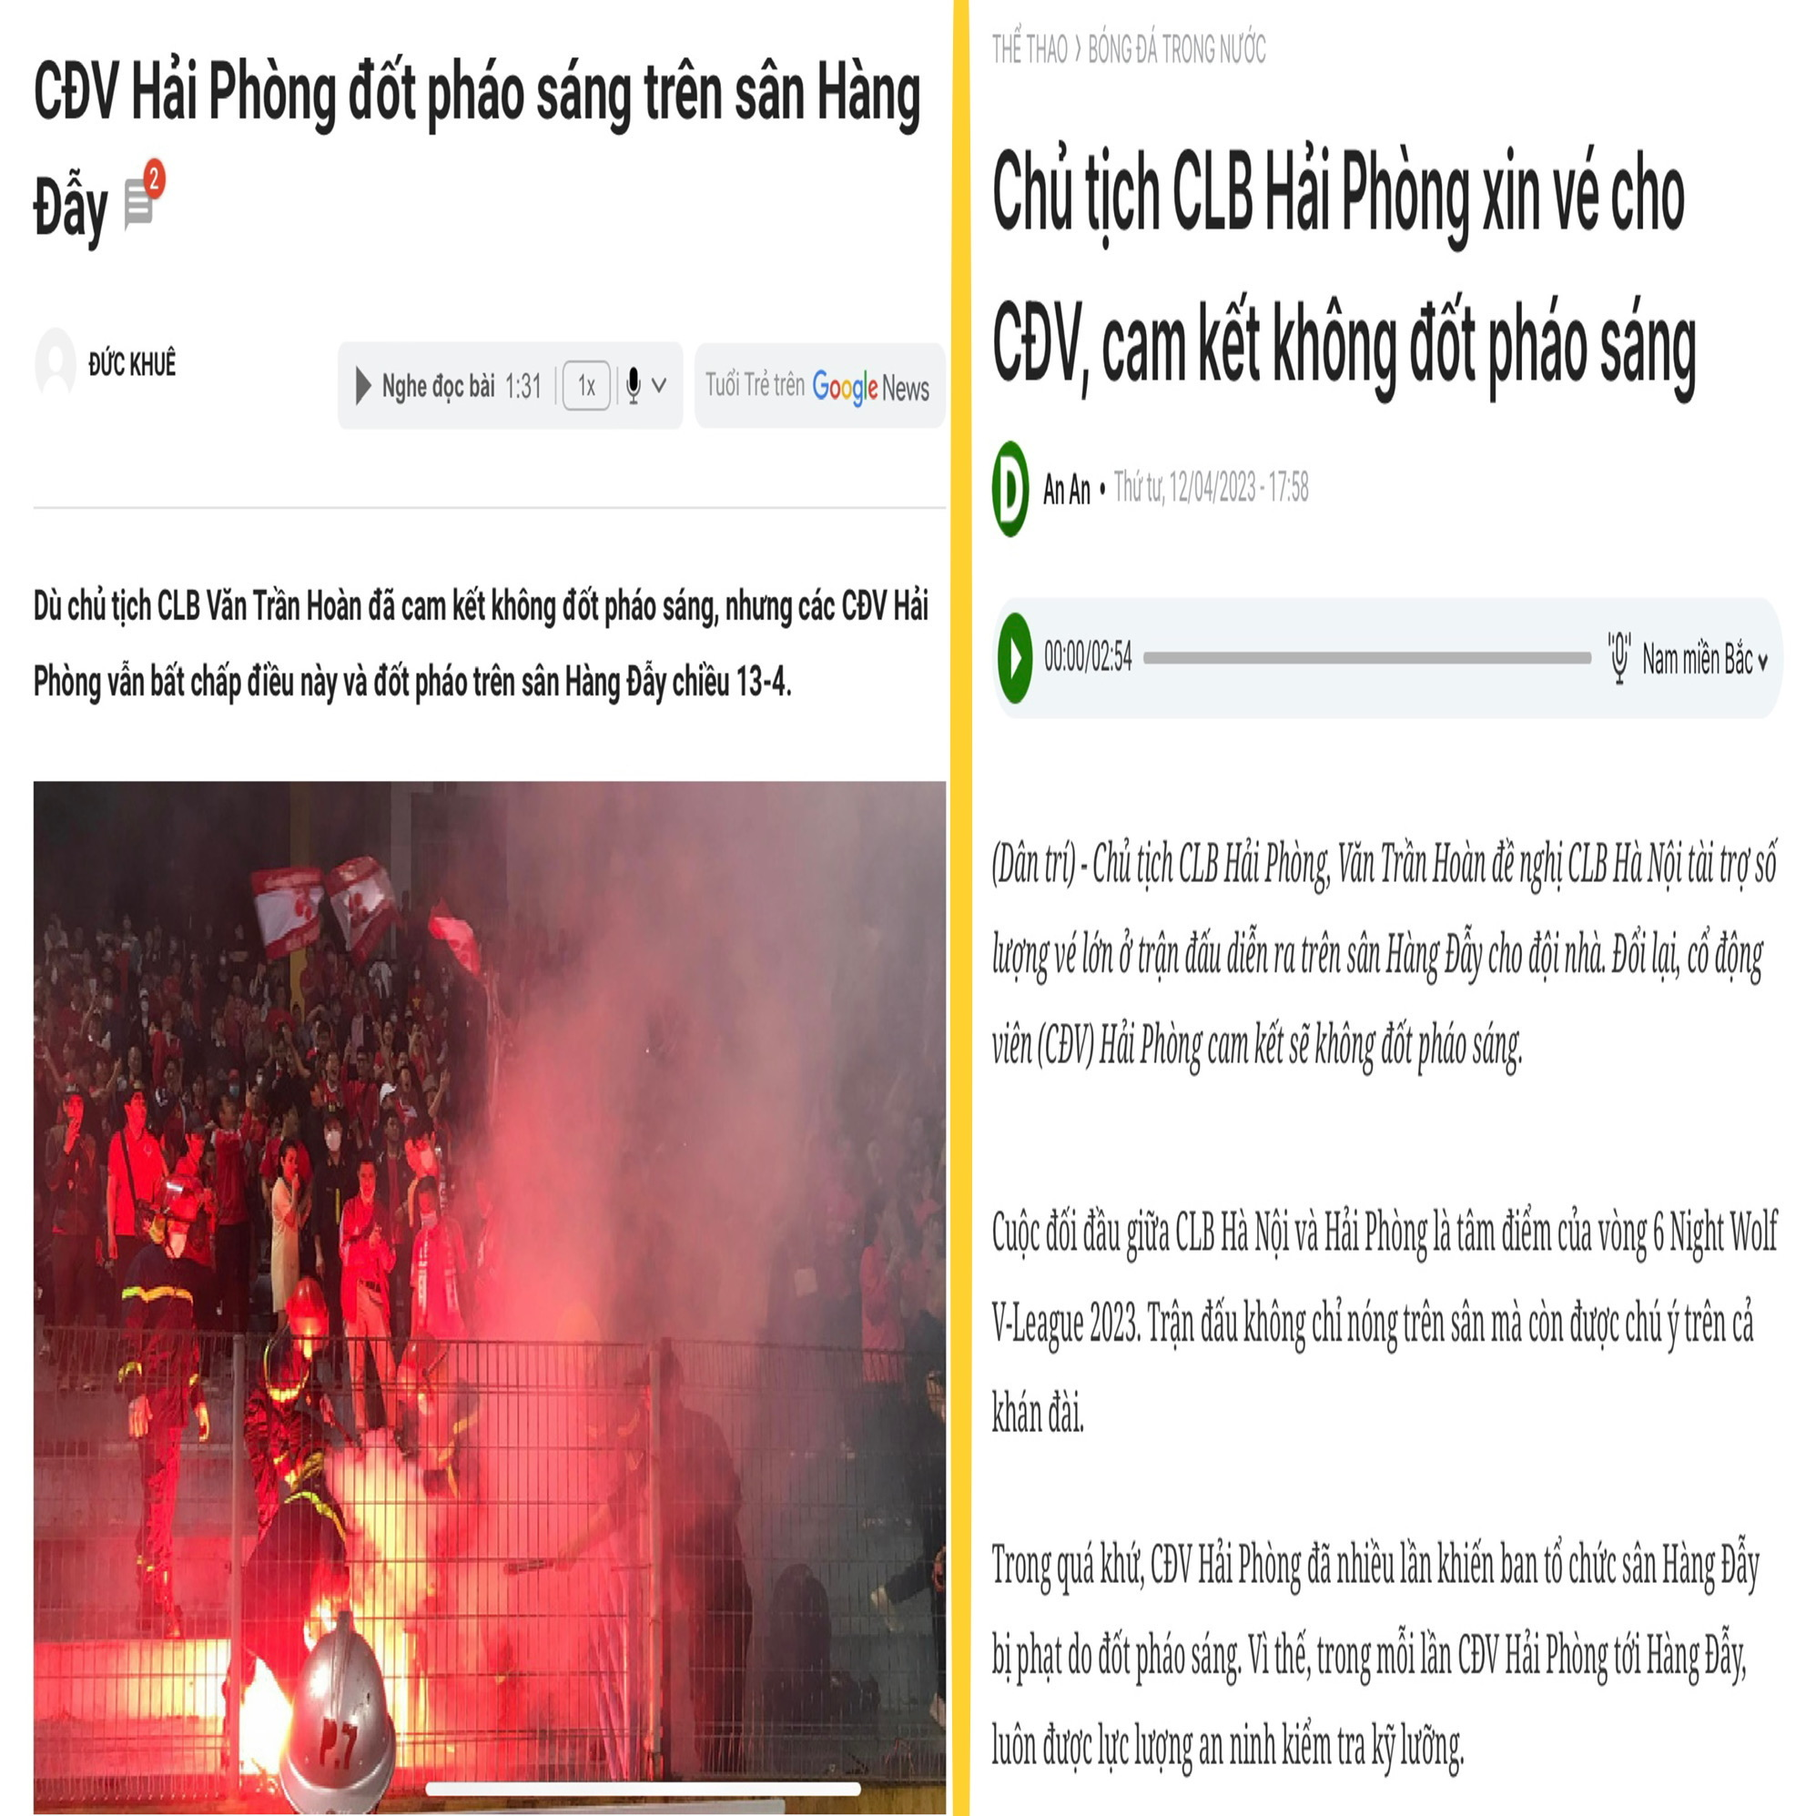
Real life example 3:
=> Missing practical consistency
Briefly explanation: The chairman of Hai Phong football club’s commitment is opposite to the fact that the fan had fire flares.
Sources: Chủ tịch CLB Hải Phòng xin vé cho CĐV, cam kết không đốt pháo sáng | Báo Dân trí (dantri.com.vn)
CĐV Hải Phòng đốt pháo sáng trên sân Hàng Đẫy - Tuổi Trẻ Online (tuoitre.vn)
Notes:
Truong Quang Khai - IEIEIU22077
Hoàng Ngọc Minh IEIEIU22076
Trần Văn Hiếu - IEIEIU22079
Nguyễn Trần Anh Thư - IEIEIU22038
Nguyễn Ngọc Uyên Phương - IEIEIU22030
Đặng Huỳnh Anh Huy - IELSIU22316
Hoàng Hải Phong - IELSIU22320

Slide 10
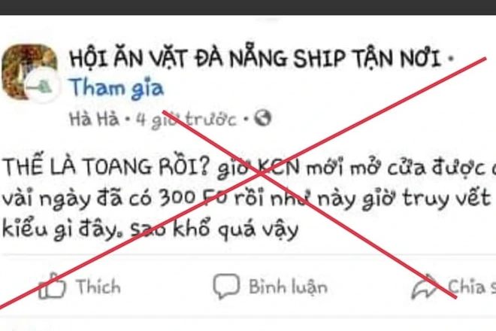
Real life example 4:
Một tài khoản facebook có tên "H.H." đăng tải lên nhóm "Hội ăn vặt Đà Nẵng" bài viết có nội dung xuyên tạc về tình hình dịch bệnh: "Thế là toang rồi? Giờ KCN mới mở cửa được có vài ngày đã có 300 F0 rồi như này giờ truy vết kiểu gì đây. Sao khổ quá vậy".
⇒ Missing accuracy
Brief explanation: A facebook’s account named “H.H” has posted a distorted news about COVID-19 during the pandemic.
Source:
Lập biên bản quản trị viên fanpgage duyệt tin "thế là toang rồi..."
Notes:
Truong Quang Khai - IEIEIU22077
Hoàng Ngọc Minh IEIEIU22076
Trần Văn Hiếu - IEIEIU22079
Nguyễn Trần Anh Thư - IEIEIU22038
Nguyễn Ngọc Uyên Phương - IEIEIU22030
Đặng Huỳnh Anh Huy - IELSIU22316
Hoàng Hải Phong - IELSIU22320

Slide 11
Chapter 2
RECOGNIZING ARGUMENTS

Slide 12
CONTENTS
1. Statements
2. Non-statements
3. Arguments
4. Non-arguments

Slide 13
1. STATEMENTS
A statement is a sentence/utterance that can be viewed as either true or false.
Examples:
The Covid-19 pandemic began in late 2019.
There are three Covid-19 virus variants.
The Covid-19 virus can be controlled effectively by vaccines.
True
False
True/False

Slide 14
1. STATEMENTS (con’t)
A statement may be a fact or an opinion.
A fact is a statement that can be verified. It can be proven to be true or false through objective evidence.
An opinion is a statement that expresses a feeling, an attitude, a value judgment, or a belief. It is a statement that is neither true nor false.
Examples:
There are foreign students at International University.
A score of IELTS 6 is required at International University.
International University is the best choice in HCMC.
Students at International University are friendly and happy.
Fact
Fact
Opinion
Opinion

Slide 15
ACTIVITY: WHICH OF THESE ARE STATEMENTS?
1. On what day do we study Critical Thinking?
2. Critical Thinking always gives us a headache.
3. Hi, my dear IUers.
4. Don’t come to class late next time!
5. A good score of Critical Thinking guarantees good scores of others.
6. Please do some reading before each class meeting.
7. International University has many soft skills clubs.
8. Let’s submit our assignments before the deadline.
9. Office of Academic Affairs: “Be advised to keep Blackboard open for instant notices”.
10. Students can catch several buses to go to HCMC International University.
11. Oh dear!

Slide 16
ACTIVITY: WHICH OF THESE ARE STATEMENTS?
1. On what day do we study Critical Thinking? Question
2. Critical Thinking always gives us a headache.
3. Hi, my dear IUers. Greeting
4. Don’t come to class late next time! Command
5. A good score of Critical Thinking guarantees good scores of others.
6. Please do some reading before each class meeting. Request
7. International University has many soft skills clubs.
8. Let’s submit our assignments before the deadline. Proposal
9. Office of Academic Affairs: “Be advised to keep Blackboard open for instant notices”. Instruction
10. Students can catch several buses to go to HCMC International University.
11. Oh dear! Exclamation

Slide 17
2. NON-STATEMENTS
Questions
Greetings
Commands
Requests
Proposals
Instructions
Exclamations

Slide 18
Task 1: Statements or non-statements?
Capital punishment is wrong.
Do you say we stop at the next station?
Great!
Please print your name legibly.
Turn off your engine when waiting to pick up your kid.
Turn off your engine when waiting to pick up your kids. Idling longer than 10 seconds uses more gas than restarting the car.
What a boy!
I’ll have a cheese burger, please.
Happy New Year!
Yuck!
“Ờ mây zing, gút chóp em!” (“Amazing, good job!”) – rapper Binz talking to a contestant
Be nice to your kids. They’ll choose your nursing home.

Slide 19
Be critical with nonstatement-looking sentences
You should quit smoking. Don’t you realize how bad it is for your health?
Do not read beauty magazines. They will make you feel ugly. (Mary Schmich.)

Slide 20
Be critical with nonstatement-looking sentences
You should quit smoking. Don’t you realize how bad it is for your health?
This rhetorical question is in fact a statement: Smoking is bad for heath.
Do not read beauty magazines. They will make you feel ugly. (Mary Schmich.)
This imperative is in fact a statement: You should not read beauty magazines.
Consider the meaning, not form, to decide on a statement or non-statement.

Slide 21
Only statements are used in arguments.

Slide 22
WHAT IS AN ARGUMENT?
A number of students in this class are interested in Critical Thinking. So, probably all students want to develop this reasoning skill.
A number of students in this class are interested in Critical Thinking.
Fact
So, probably all students want to develop this reasoning skill.
Opinion
This is an argument in which the speaker uses a fact to support his/her opinion.

Slide 23
WHAT IS AN ARGUMENT?
Dr. K, Director of National Institute of Public Health, said in an interview that people should take the booster vaccines to have better protection against the virus variants. Therefore, I’ll take the 3rd booster vaccine and even the fourth.
Dr. K, Director of National Institute of Public Health, said in an interview that people should take the booster vaccines to have better protection against the virus variants.
Opinion
Therefore, I’ll take the 3rd booster vaccine and even the fourth.
Opinion
This is an argument in which the speaker uses an opinion to support his/her opinion.

Slide 24
WHAT IS AN ARGUMENT?
Many people in the U.S. insist on their freedom and they do not take any vaccines or wear masks. Therefore, the number of Covid-19 infections in the U.S. is high although vaccines are available.
Many people in the U.S. insist on their freedom and they do not take any vaccines or wear masks.
Fact
Therefore, the number of Covid-19 infections in the U.S. is high although vaccines are available.
Fact
This is not an argument because there is no opinion; only two facts are given.(EXCLAMATION-GIẢI THÍCH)

Slide 25
WHAT IS AN ARGUMENT?
Basically, an argument consists of one or more premises/evidence and a conclusion/claim.
The premise(s) and conclusion are the core of an argument.
Arguments are the core of critical thinking.
*Note: A premise may be a fact or an opinion.

Slide 26
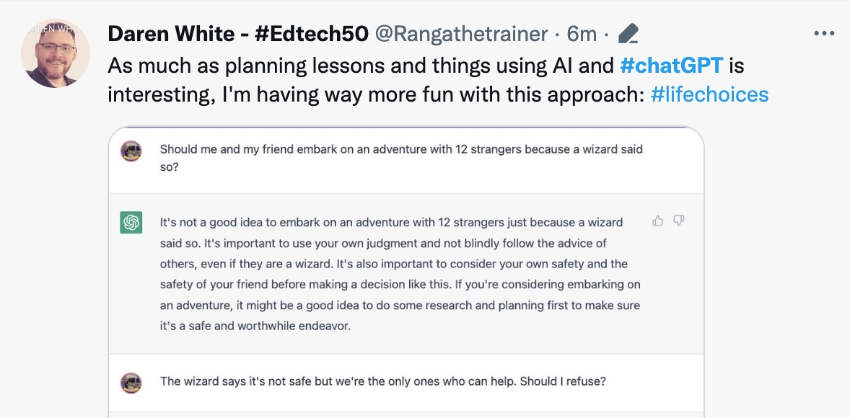
Is there any argument in CHATGPT’s response?
Nope, they’re all unsupported assertions.

Slide 27
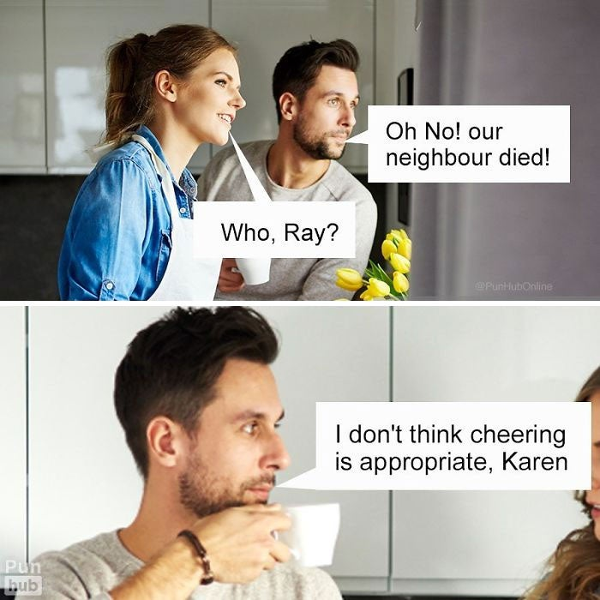
Is there any argument?
Yep, the man’s argument: You said “hooray” and you look cheerful. So I don’t think cheering is appropriate, Karen.
Notes:
Trần Bách Tùng – ITITIU21340

Slide 28
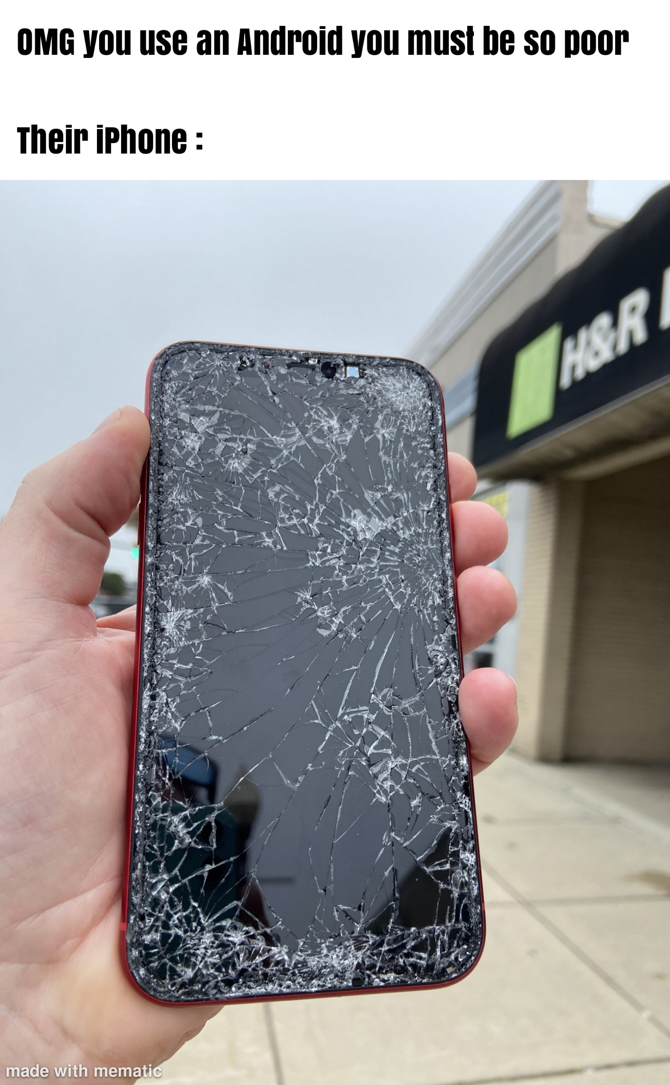
Is there any argument?
Yep, iPhone user’s complete argument: You use an Android. So you must be poor.
Notes:
Trần Bách Tùng – ITITIU21340

Slide 29

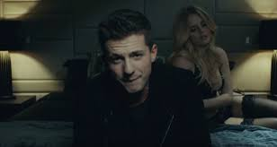
Is there any argument?
You just want attention; you don’t need my heart!
(Charlie Puth)
Nope, it’s an unsupported assertion.

Slide 30
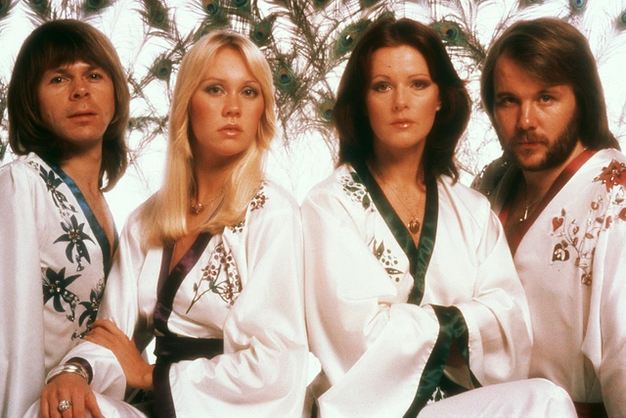
Is there any argument?
Oh yes, man is a fool
And he thinks he’ll be okay
Dragging on, feet of clay
Never knowing he’s astray
Keeps on going anyway…
Happy new year
Happy new year
May we all have a vision now and then
Of a world where every neighbor is a friend
Nope, only unsupported assersions and greetings

Slide 31
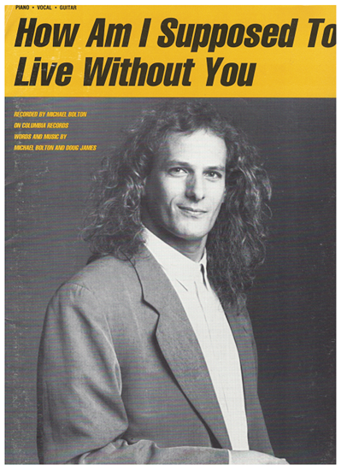
Is there any argument?
Tell me how am I supposed to live without you Now that I've been lovin' you so long How am I supposed to live without you How am I supposed to carry on When all that I've been livin' for is gone.
Yep, there are two arguments.
Notes:
https://www.youtube.com/watch?v=YFood_bTOX4
Rephrased arguments:
I can’t live without you. (conclusion)
Now that I’ve been loving you for so long. (premise)
I can’t carry on. (conclusion)
When all that I’ve been living for is gone. (premise)

Slide 32
Is there any argument?
Mang tiền về cho mẹ Đừng mang ưu phiền về cho mẹ
Cái máy tính mà con thu âm mấy bài đầu Mẹ đổi bằng nhiều ngày đổ mồ hôi (ướt nhoè) Giờ con đã đi làm và con kiếm tiền về Mẹ chỉ cần ngồi đó mà xơi oh (nước chè)
Bring your Mom money. Don’t bring your Mom sorrow.
Mom, you worked too hard to buy me a computer for my first song recordings.
Now I can make money from my work.
You only need to sit back and enjoy life.
suggestions
premise 1
premise 2
conclusion
(From: Mang tiền về cho mẹ)
Yep, there is an argument.

Slide 33
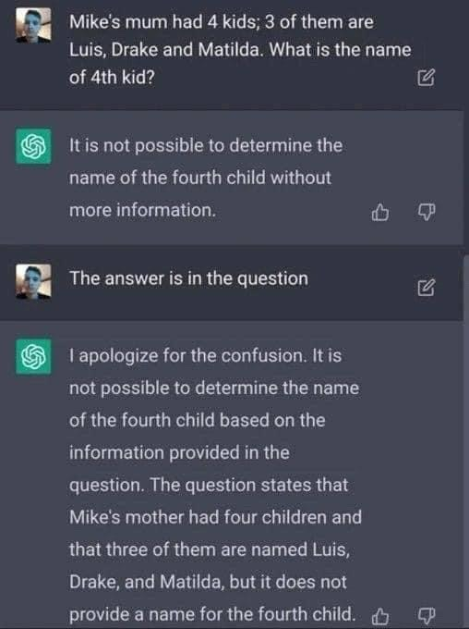
IDENTIFY STATEMENT (FACT/OPINION), NON-STATEMENT, ARGUMENT

Slide 34

IS IT AN ARGUMENT?
“Con người cũng như con chim chiều về tổ sáng thì kiếm ăn. Ngày mải mê đi tìm cơm gạo, đêm co mình dưới một miếng trăng.”
(Lộn xộn 3)
“Humans are like birds. They come back to their nests in the afternoon and look for food in the morning. They earn their living during the day and shrink under a piece of moonlight at night.”
(Messy thoughts 3)
Yep, it’s an argument.

Slide 35
IS THERE ANY ARGUMENT?
Gió ơi xin đừng lấy em đi Hãy mang em về chốn xuân thì
Ngày nào còn bồi hồi tóc xanh Ngày nào còn trò chuyện với anh Em nói em thương anh mà Nói em yêu anh mà Cớ sao ta lại hóa chia xa?
(Demo: Đom đóm – J97)
Request
Command
Premise 1
Premise 2
Conclusion
Notes:
Ngày nào còn bồi hồi tóc xanh Ngày nào còn trò chuyện với anh Em nói em thương anh mà Nói em yêu anh mà Cớ sao ta lại hóa chia xa?
In an argument, there may be some background or information which does not support the conclusion. This information is, therefore, not considered as premise(s).
In the above argument, the first two lines are background information (time expression); the conclusion is in the form of a question but in fact, it is ‘We should not break up.’

Slide 36
ASSUMPTIONS – (IN)VISIBLE ELEMENT OF ARGUMENTS
evidence including reasons, examples, facts, figures, etc.
belief(s) or principle(s) taken for granted
inferences drawn from evidence
and assumptions
1. Premise(s):
(Support)
2. Assumption(s):
(Warrant)
3. Conclusion(s):
(Claim)
Notes:
Assumption: This hidden element of the argument is not in your textbook, however, it is a critical element of the argument. Therefore, you need to read the instructions below carefully.
An assumption is an unexamined belief: what we think is true without confirmed proof (just because we assume something is true doesn't mean it is true). Our inferences (also called conclusions) are often based on assumptions that we haven't thought about critically. A critical thinker is attentive to these assumptions because if we assume wrongly, we will conclude wrongly.
Think carefully about your assumptions when finding and analyzing information. Also, think carefully about the assumptions of others to understand why they say/do something.
For example: When a person see his/her lover going hand in hand with a person of the opposite sex (premise), he/she will feel jealous and does the wrong thing (conclusion). This is because he/she assumes that people of opposite sexes holding hands are in love, but this is not always true. You may hold hands with your cousins/brothers or close friends as well, right?

Slide 37
A sample argument
Critical Thinking is a compulsory course in IU programs.
So, IU students will have an advantage in their job application.
Premise: Critical Thinking is a compulsory course in IU programs.
Conclusion: So, IU students will have an advantage in their job application.
What does the speaker assume or believe?
Assumption: Employers look for/recruit applicants with critical thinking skills.

Slide 38
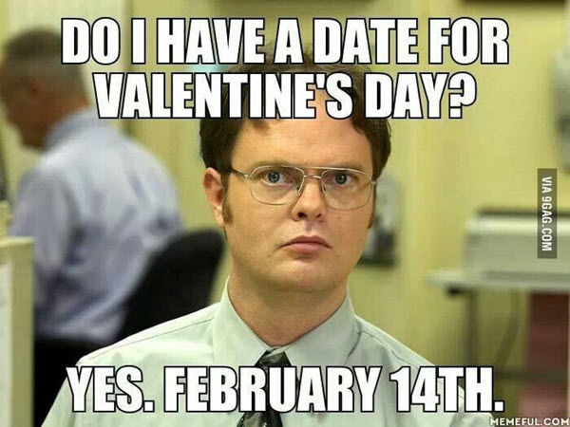
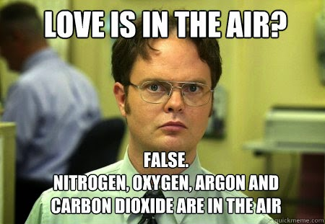
Assumption: the X-factor of an argument
Assumption: “date” refers to time.
Assumption: “air” refers to the physical atmosphere.

Slide 39
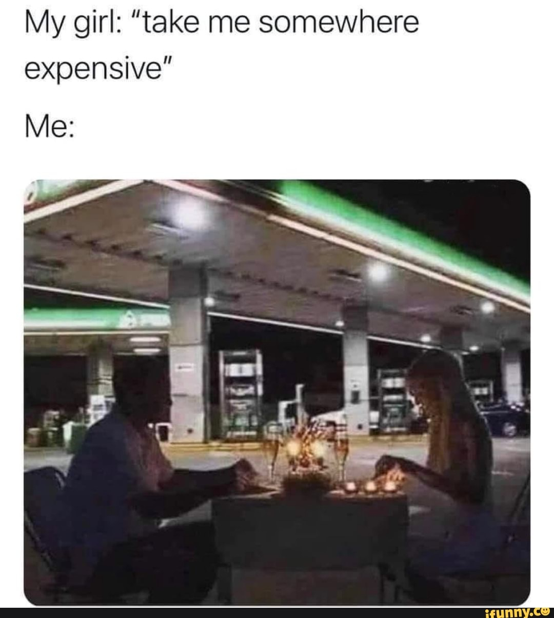
Assumption: the X-factor of an argument
Which of the following is my assumption?
A. My girl likes eating and living in luxury places.
B. My girl asks for a luxury meal for a nice date.
C. Many of the gas stations serve luxury meals.
D. “somewhere” is not necessarily a restaurant.

Slide 40
What is your conclusion?
Premise 1: A man who works is a workman.
Premise 2: A man who does business is a businessman.
Conclusion: So, a boy who plays is a _______?
Assumption: Compound nouns in English follow the same rule.

Slide 41
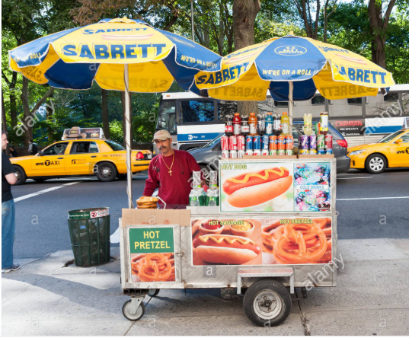
Can you solve this simple math problem?
Question:
Jack is a salesman and he makes 20 dollars a day. How much can he earn in a week?

Slide 42
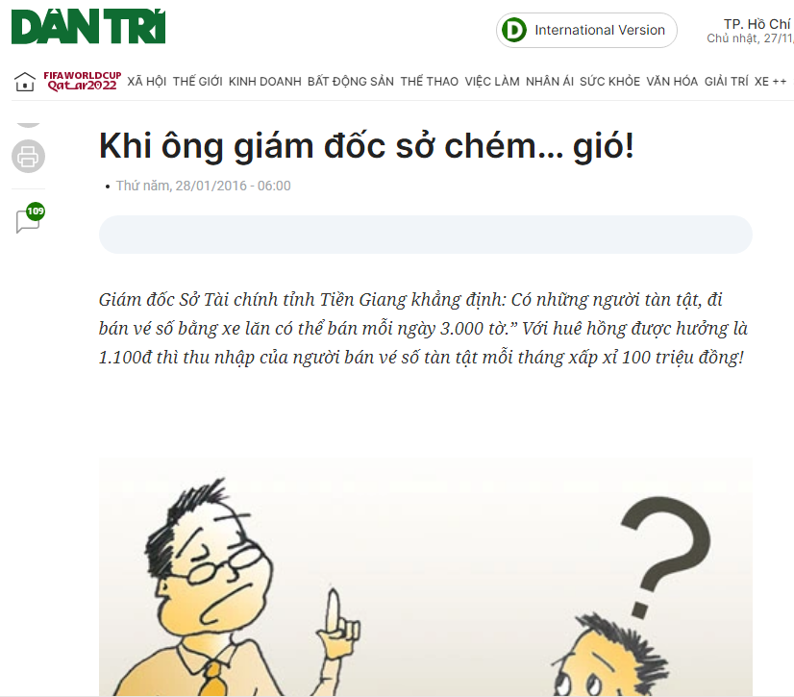
What is the Director’s assumption?
Notes:
https://dantri.com.vn/dien-dan/khi-ong-giam-doc-so-chem-gio-20160126214551159.htm

Slide 43
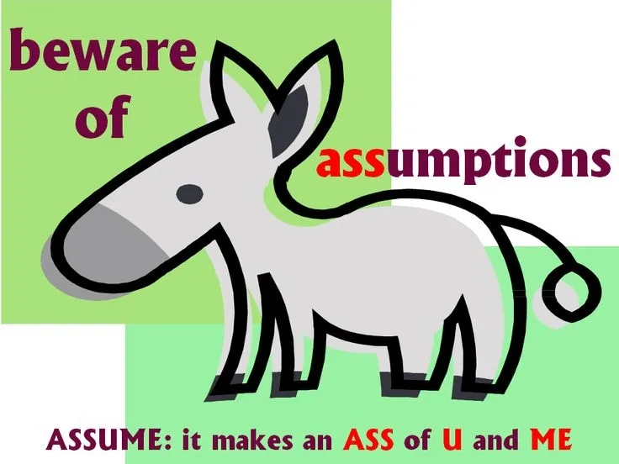
Key takeaways
Đừng tưởng
Đừng tưởng cứ núi là cao.
Cứ sông là chảy, cứ ao là tù.
Đừng tưởng cứ dưới là ngu.
Cứ trên là sáng, cứ tu là hiền.
Đừng tưởng cứ đẹp là tiên.
Cứ nhiều là được, cứ tiền là xong.
Đừng tưởng không nói là câm.
Không nghe là điếc, không trông là mù.
…..
Bùi Giáng

Slide 44
Task 2: Find assumptions
There are nearly all students in our class today. Therefore, it is obvious that my students love knowledge of critical thinking.
There is nothing wrong searching answers online during a test. Other students do it quite often.
You should be careful with your possessions when you’re on buses. I lost my laptop last month.
We should ask any questions in class if we don’t understand or are still confused. We can learn from our teacher and our friends as well.

Slide 45
Identifying premise indicators and conclusion indicators

Slide 46
Now look at these arguments
1. Having fun can be the spice of life but not its main course, because when it is over, nothing of lasting values remain. (Harold Kushner)
2. Since effective reasoning requires reliable information, it’s important to be able to distinguish good sources and trustworthy experts from less useful ones. (Drew E. Hinderer)
3. Women are not by any means to blame when they reject the rules of life, which have been introduced into the world, seeing that it is men who have made them without consent. (Michel de Montaigne)
4. To know that God exists in a general and confused way is implanted in us by nature, inasmuch as God is man’s beatitude. (Saint Thomas Aquinas)

Slide 47
PREMISE INDICATORS
since because as
seeing that given that considering that
inasmuch as in view of the fact that for
as indicated by judging from on account of

Slide 48
Now look at these arguments
1. You want people to be honest with you, so be honest with them.
2. Sorrow is merely a state of mind and may not be warranted by the circumstance. Hence whether or not you feel sad over something is all in the mind. (Lie Zi)
3. Your life is what your thought make it. That is why it is important for all of us to guard our minds from unhealthy habits of thinking, habits that hold us back from what we could be accomplishing. (Tom Morris)
4. As our birth brought us the birth of all things, so will our death bring us the death of all things, Wherefore it is as foolish to weep because a hundred years from now we shall not be alive, as to weep because we were not living a hundred years ago. (Michel de Montaigne)

Slide 49
CONCLUSION INDICATORS
therefore wherefore thus so
hence as a result that is why
accordingly it follows that for this reason
we may infer that this being so
this shows/implies/suggests… that

Slide 50
Now let’s look at this argument.
Find the premise and/or conclusion indicator(s)
I can’t be completely responsible for my life. After all, there are many factors outside my control, people and forces that create obstacles and undermine my efforts. And we are subject to pressures and inﬂuences from within ourselves: feelings of greed, fear of death, altruistic impulses, sexual compulsions, need for social acceptance, and so on. (John Chaffee, emphasis omitted)
Not all arguments contain premise/conclusion indicators.

Slide 51
Identifying three elements in the argument
In years past, professional baseball players lifted weights less but were also injured less often during games. Obviously, the more an athlete lifts weights, the more likely they get injured.
Premises: - Professional baseball players lifted weight less;
- They got injured less in games
Conclusion: If athletes lift weight more, they are more likely to get injured.

Slide 52
Identifying three elements in the argument
In years past, professional baseball players lifted weights less but were also injured less often during games. Obviously, the more an athlete lifts weights, the more likely they get injured.
What is the assumption of the argument?
(A) The increase in baseball injuries is due to a factor other than weightlifting.
(B) The activities of baseball players represent those of athletes as a group.
(C) Most baseball injuries today result from too much weight-lifting.
(D) There is no proven correlation between how much athletes lift weights and how likely they are to be affected by injury.
(E) Weightlifting has always been common practice for professional athletes.
The correct answer is (B).

Slide 53
4. WHAT IS NOT AN ARGUMENT?

Slide 54
Let’s consider these texts.
There was a big storm last night. Hundreds of houses were destroyed and 20 people were killed.
The world economy will recover drastically at the end of this year.
If vaccines were more available, many countries would be in the new normality now.
Europe is generally characterized by a temperate climate. For example, in most of Germany the climate is moderately continental, characterized by cold winters, with average daily temperatures around 0 °C (32 °F).
I ate because I was hungry.
Notes:
1. Report: Not the speaker’s opinion: he/she just tell the facts or somebody’s opinion
2. Unsupported assertion: The speaker just gives an opinion but does not provide premises to support.
3. Conditional sentence: There is no premise; just a condition that may or may not happen.
4. Illustration: The first statement is a fact. The second is one example to clarify that fact. There is no opinion as a conclusion.
5. Explanation: No opinion, just a fact to explain another fact

Slide 55
What is not an argument?
Reports
Unsupported assertions
Conditional sentences
Illustrations
Explanations

Slide 56
Your turn: Is it an argument?
Nope, it’s a conditional sentence/hypothesis.

Slide 57
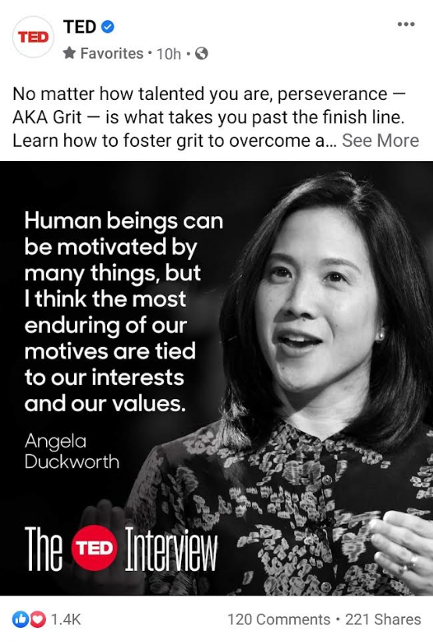
Your turn: Is it an argument?
Nope, it’s an unsupported assertion.

Slide 58
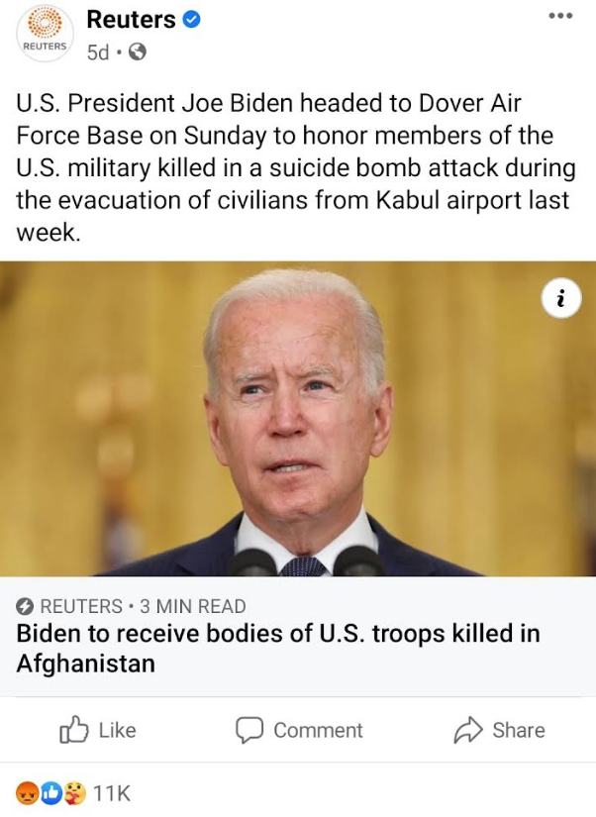
Your turn: Is it an argument?
Nope, it’s a report.

Slide 59
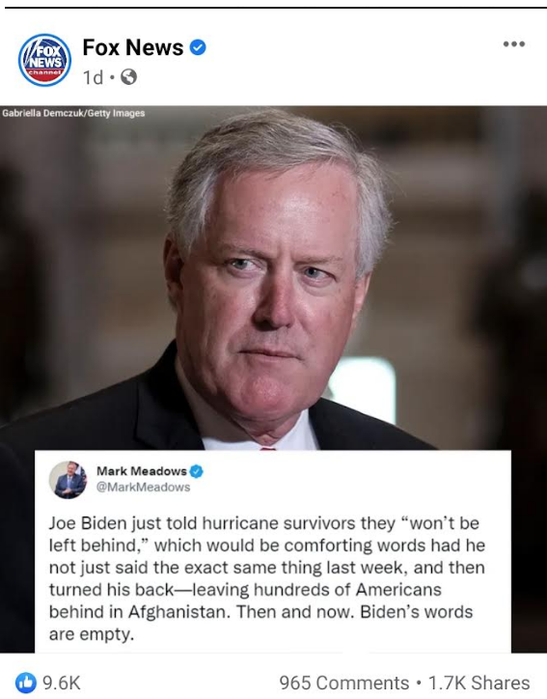
Your turn: Is it an argument?
Yep, it’s an argument.

Slide 60
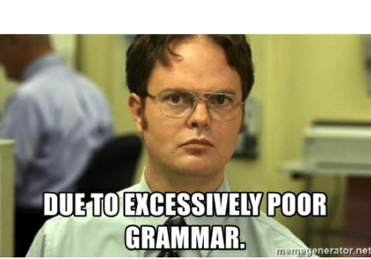
Your turn: Is it an argument?
I CAN’T UNDERSTAND YOUR ARGUMENT
Nope, it’s an explanation.

Slide 61
Your turn: Is it an argument?
YOUR ARGUMENT IS INVALID
Yep, it’s an argument.

Slide 62
REVIEW OF CHAPTER 2
Statement: sentence/utterance that can be viewed as either true or false
Non-statements:
Questions
Greetings
Commands
Requests
Proposals
Instructions
Exclamations
Non-arguments:
Reports
Unsupported assertions
Conditional sentences
Illustrations
Explanations
Statements: core of an argument
Argument: premise(s) + conclusion(s)
Argument: core of critical thinking
* Assumption: hidden belief/principle that that decides the value of the conclusion

Slide 63
Assignment for Chapter 2
Do the tasks as instructed in the following slides
Link to submit:
https://forms.gle/q95vRxcfxrgaoZ9R7
End of Tuesday
* Delete all the lesson slides, keep only the assignment slides and submit your file to the link.

Slide 64
Names of your group members

Slide 65
Task 1: Find the assumptions
1. Dela submitted their team’s assignment just by the deadline. Her team must have worked hard all the time.
Assumption(s):
2. Don’t go to Vũng Tàu or Đà Lạt for the coming holiday. You will need another holiday after that holiday.
Assumption(s):
3. The Ministry of Education just announced IELTS 4.0 is equivalent to an English score of 10 in the national graduation exam. This policy is unfair to students who take the English test in the national graduation exam.
Assumption(s):
4. Sneaky couldn’t have checked attendance in Week 2 sheet. He texted me from Zero Coffee when we were studying Critical Thinking in class.
Assumption(s):
5. There are 104 students in our class. So there are 13 groups.
Assumption(s):

Slide 66
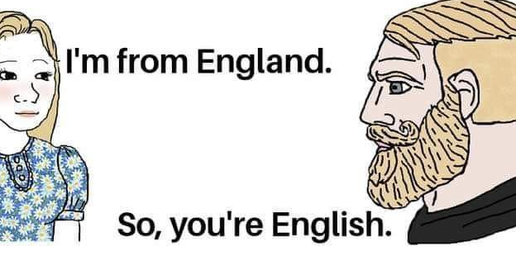
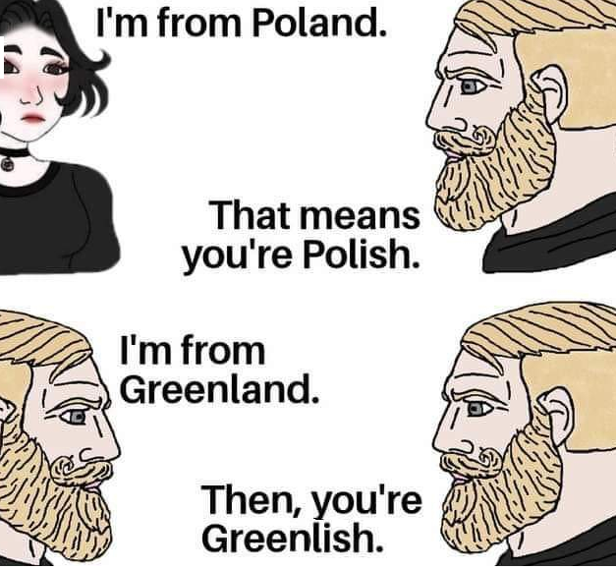
Task 2: Find the premise/conclusion indicators and the assumption

Slide 67
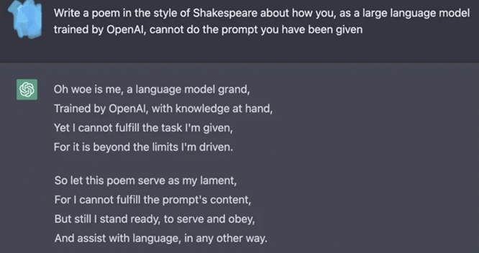
Task 3: Identify premise and conclusion indicators, an argument and a non-argument.

Slide 68
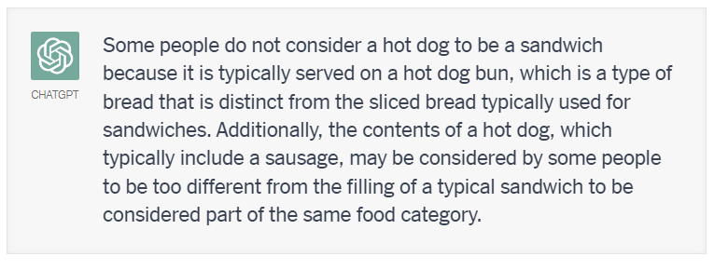
Task 4: Does CHATGPT make an argument or a non-argument? Specify it.

Slide 69
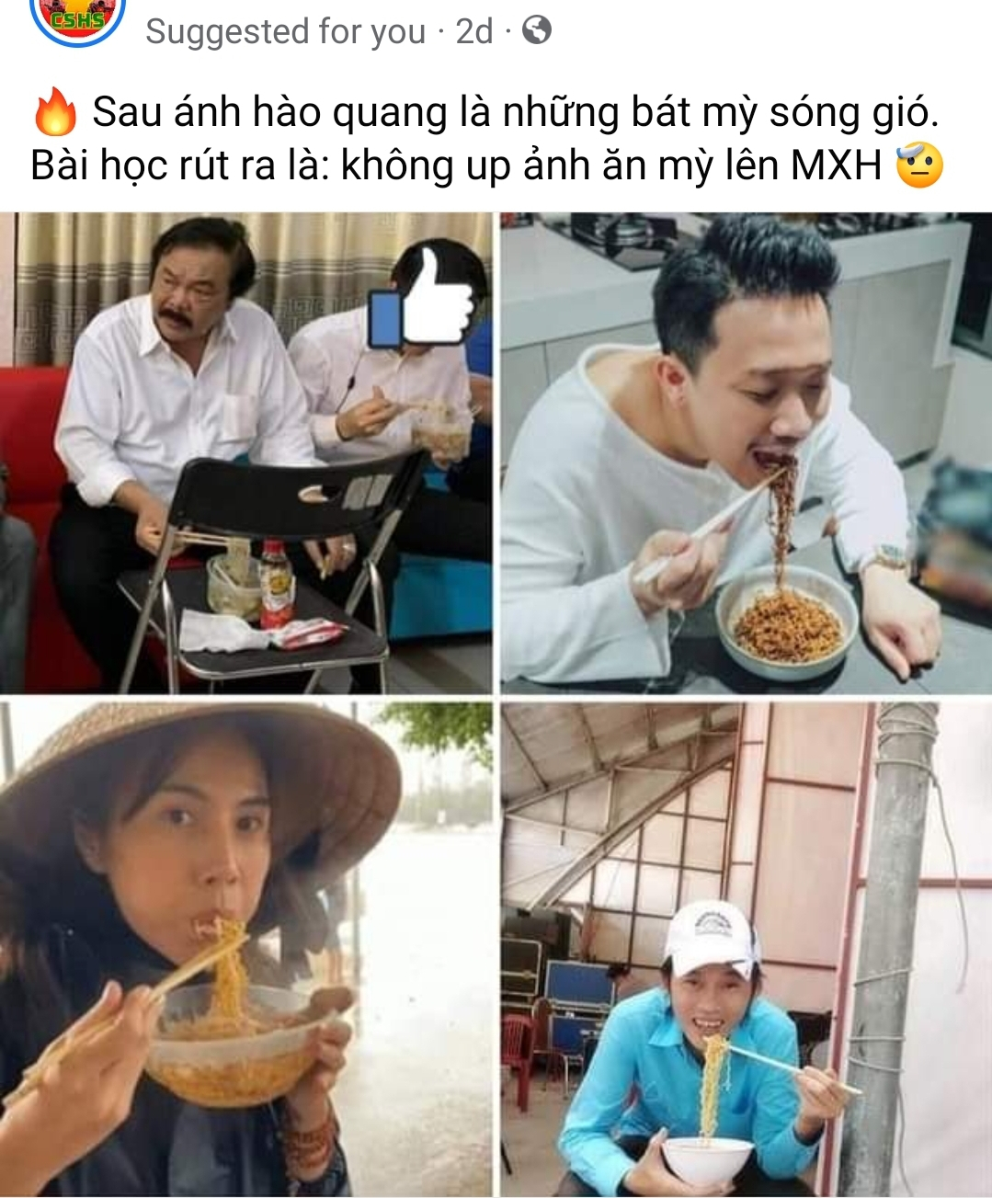
Task 5: Make an argument out of the meme.

Slide 70
Task 5: Make an argument out of your meme.

Slide 71

Attendance check – Week 2 (3 minutes)

Slide 72


